Slide 1
Understanding and Combating Investment Fraud
Pension Research Council Symposium – May 6, 2016
Notes:
1

Slide 2
Protecting Consumers from Fraud
Growing Body of Research
Impact of Self-Reporting Error
Individual Differences
Susceptibility
Psychological Biases
Risk Behavior
Victim Profile

Slide 3
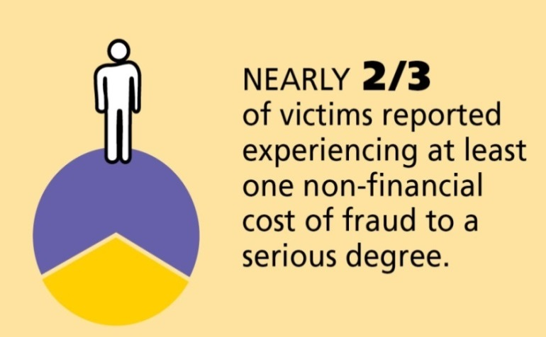
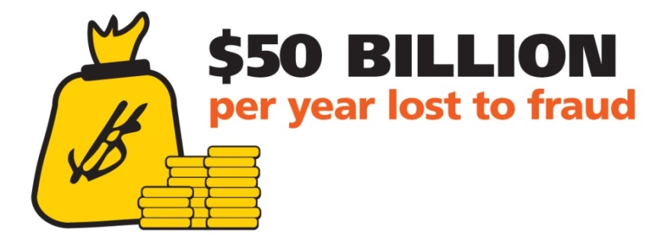
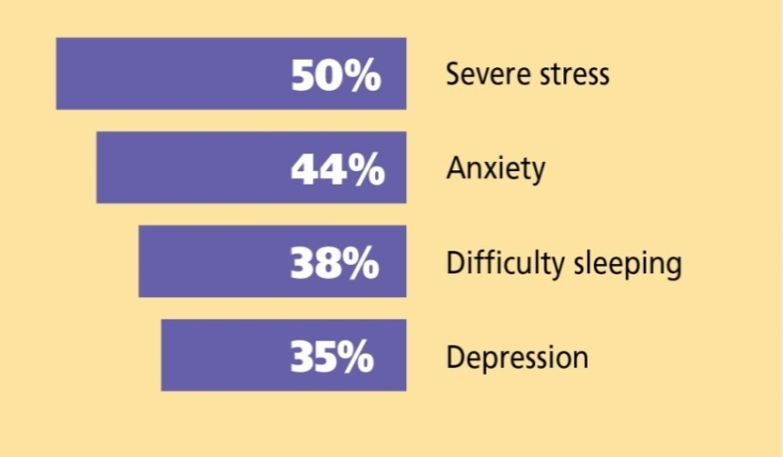
Fraud Prevalence and Impact
Financial fraud prevalence is hard to measure. Estimates vary from about 4 to 14 percent.
Sources: FINRA Investor Education Foundation research reports, Financial Fraud and Fraud Susceptibility in the United States (2013)
and Non-Traditional Costs of Financial Fraud (2015). Stanford Center on Longevity research report, Scams, Schemes & Swindles: A Review of Consumer Financial Fraud Research (2012)

Slide 4
Fraud Weapon – Social Influence
Scam pitches are tailored to the “hot buttons” of targets
An investment fraud pitch is full of influence
Source: Consumer Fraud Research Group, Off the Hook Again: Understanding Why the Elderly Are Victimized by Economic Fraud Crimes (2006)

Slide 5
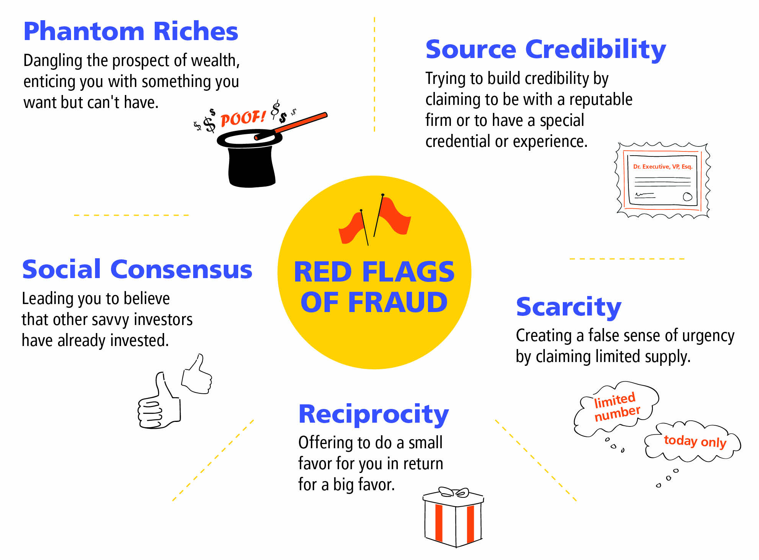
Red Flags of Fraud

Slide 6
Investment Fraud Victim?
Fraud victims are stupid, naïve, gullible, greedy, mentally deficient, elderly, and easily-led.
Notes:
6

Slide 7
The Demographics of Fraud
No single victim stereotype
Age and fraud victimization
Beyond age
Gender
Income
Education

Slide 8
The Psychographics of Fraud
Risk tolerance
Perceptions of debt
Impulsiveness
Financial literacy

Slide 9
The Role of Targeting
Two kinds of vulnerability
Falling victim once targeted
Likelihood of being targeted
Examine the role of demographics, psychographics and targeting on investment fraud

Slide 10
The Role of Targeting
Source: Authors’ calculations based on data from the Fraud Susceptibility Study (2013) and the National Financial Capability Study (2012).

Slide 11
The Role of Targeting

Slide 12
The Role of Targeting
Source: Authors’ calculations based on data from the Fraud Susceptibility Study (2013) and the National Financial Capability Study (2012).

Slide 13
Who Tends to Get Targeted?
Older
Male
Higher Income
College Educated

Slide 14
Challenges to Preventing Fraud
Psychological Barriers
Illusion of invulnerability (I can’t be taken.)
Reactance (You’re not the boss of me.)
Threats to self-esteem (I am not stupid.)
Too much information (I can’t remember what you taught me.)
Systemic Barriers
Scams everywhere (how do you warn against so many different frauds?)
Scale (how do you reach a critical mass of consumers?)
Proving a negative (how do you show when something doesn’t happen?)
Persistence (if you can show a preventative effect, does it last?)

Slide 15
Moving Beyond Warning Campaigns
Investor alerts and warning campaigns have limited focus.
Warning Campaigns
Educating Campaigns
Specific
Generic
Reactive
Proactive
Short-term
Long-term
Information-based
Skills-based
Source: OECD, Examining Consumer Policy: A Report On Consumer Information Campaigns Concerning Scams (2005)

Slide 16
Investor Protection Strategy
Ground in research
Build partnerships
Teach Investors to:
Know that are vulnerable
Recognize persuasion techniques
Take simple, highly protective steps (“Ask and Check”)

Slide 17
Field Testing a Curriculum
Those who had been to the OIF seminar responded positively to the fraud appeal 50% less frequently than those who had not.
Source: FINRA Investor Education Foundation

Slide 18
Questions? Christine N. Kieffer, christine.kieffer@finra.org Gary R. Mottola, gary.mottola@finra.org
Notes:
18
Discuss biases
Understand influence and how persuasion plays a role in scams
Learn how to neutralize bias and influence

