Slide 1
Aging and decision-making competence
Professor Wändi Bruine de Bruin
Centre for Decision Research, Leeds University Business School (UK)
Department of Engineering & Public Policy, Carnegie Mellon University (US)
Funded by the European Union (FP7-PEOPLE-CIG-618522)

Slide 2
Aging
Population age is increasing worldwide
Older adults face difficult pension decisions
Emerging literature on aging and decision-making competence
highlights 4 main findings
has implications for pension communications

Slide 3
Overview
Key findings from literature on aging
Suggestions for interventions
Take-home messages

Slide 4
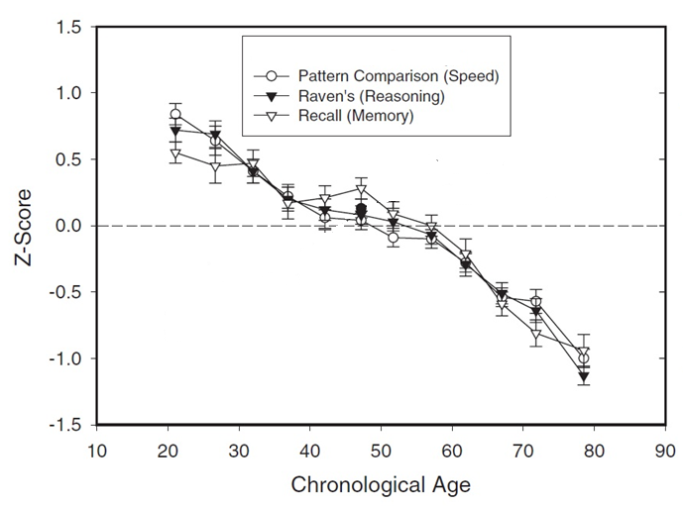
Finding 1: Cognitive decline
Older adults do worse than younger adults on complex decision tasks
But they do as well on simple decision tasks
(figure from Salthouse, Current Directiions in Psychological Science, 2004)
See: Bruine de Bruin et al., Journal of Behavioral Decision Making, 2012

Slide 5
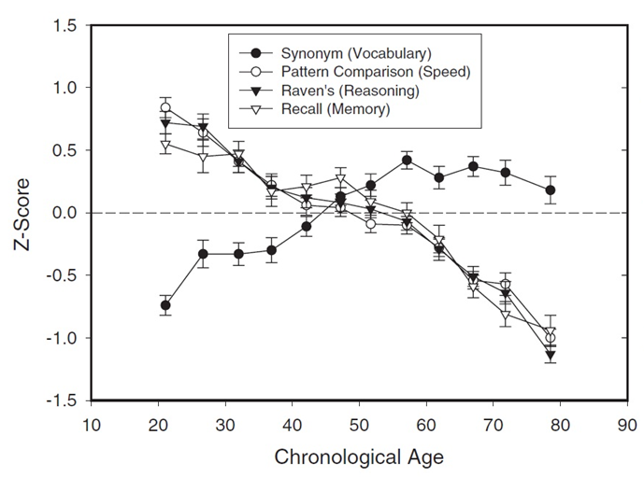
Finding 2:
Increased knowledge
Experienced decision makers may not have to think as hard about their decisions
(figure from Salthouse, Current Directiions in Psychological Science, 2004)
See: Bruine de Bruin et al., Journal of Behavioral Decision Making, 2012

Slide 6
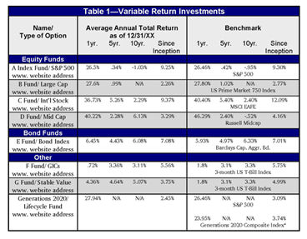
Finding 3: Age-related decline in motivation
Older adults with lower numeracy dislike numbers
But they will put effort into decisions, if relevant
See: Bruine de Bruin et al., Medical Decision Making, 2015

Slide 7
Finding 4: Better emotion regulation
Older adults report better emotional well-being
Older adults are more focused on maintaining positive emotions
Emotion goals affect decision making
See: Bruine de Bruin et al., Psychology & Aging, 2014, 2015

Slide 8
Overview
Key findings from literature on aging
Suggestions for interventions
Take-home messages

Slide 9
Suggestions for interventions
Target cognitive decline
Train cognitive skills
Provide decision aids
Build on experience
Build on familiar examples
Improve motivation
Simplify decisions and reduce choice sets
Increase personal relevance
Build on emotions
Frame information positively

Slide 10
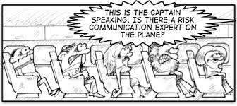
Existing communications
Many communications are disseminated without testing their effectiveness
Those that are tested are often found to be ineffective, perhaps due to
Providing information that is too complex, unfamiliar, and seemingly irrelevant
Not covering what recipients want or need to know
Not involving psychologists

Slide 11
Behavioral decision research approach to developing communications
Normative: What should people know to make more informed decisions?
Literature review and expert panel
Descriptive: What do people already know and how are they making their decisions?
Interviews and surveys
Prescriptive: What do people still need to know to make more informed decisions?
Compare step 1 and 2 to develop message
Evaluation: Does the communication help people to make more informed decisions?
Evaluate message effectiveness

Slide 12
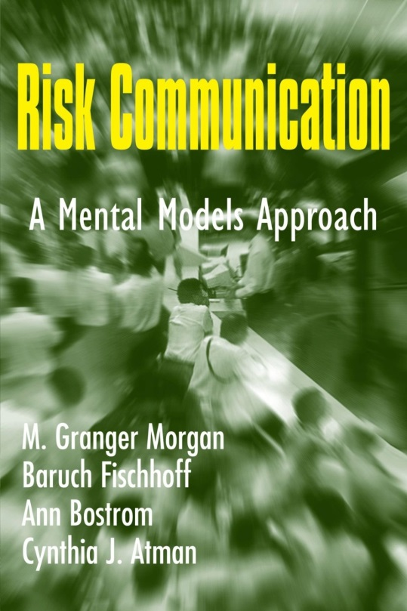
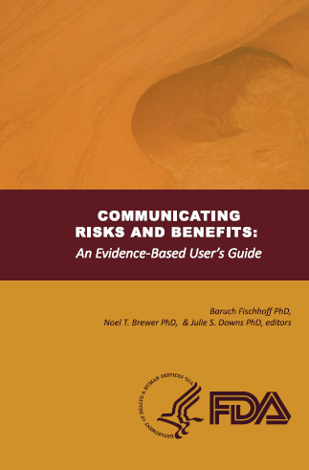
More about the methodology
Morgan, M.G., Fischhoff, B., Bostrom, A., & Atman, C. (2002). Risk communication: A mental models approach. New York, NY: Cambridge University Press.
Fischhoff, B., Brewer, N.T., & Downs, J.S. (2011). Communicating risks and benefits: An evidence-based user’s guide. USFDA.
Bruine de Bruin, W., & Bostrom, A. (2013). How to assess what to address in science communication. Proceedings of the National Academy of Sciences,110, 14062-14068.
(www.fda.gov/oc/advisory/
OCRCACACpg.html)
Also on YouTube

Slide 13
More about aging audiences

Slide 14
Overview
Key findings from literature on aging
Suggestions for interventions
Take-home messages

Slide 15
Take-home messages
Older adults face cognitive decline
Older adults also have more experience, different motivation, and emotions
Communication should be designed with audience members’ strengths and weaknesses in mind
Know your audience
Test messages before disseminating them
Psychologists can help

Slide 16
Related projects
in Centre for Decision Research
Understanding and improving older adults’ decision-making competence (funded by European Union)
Understanding age differences in patients’ preferences for health information (funded Swedish Riksbanken Jubileumsfond)
Helping older adults in financial distress (funded by EU Marie Curie Fellowship to Caezilia Loibl)

Slide 17
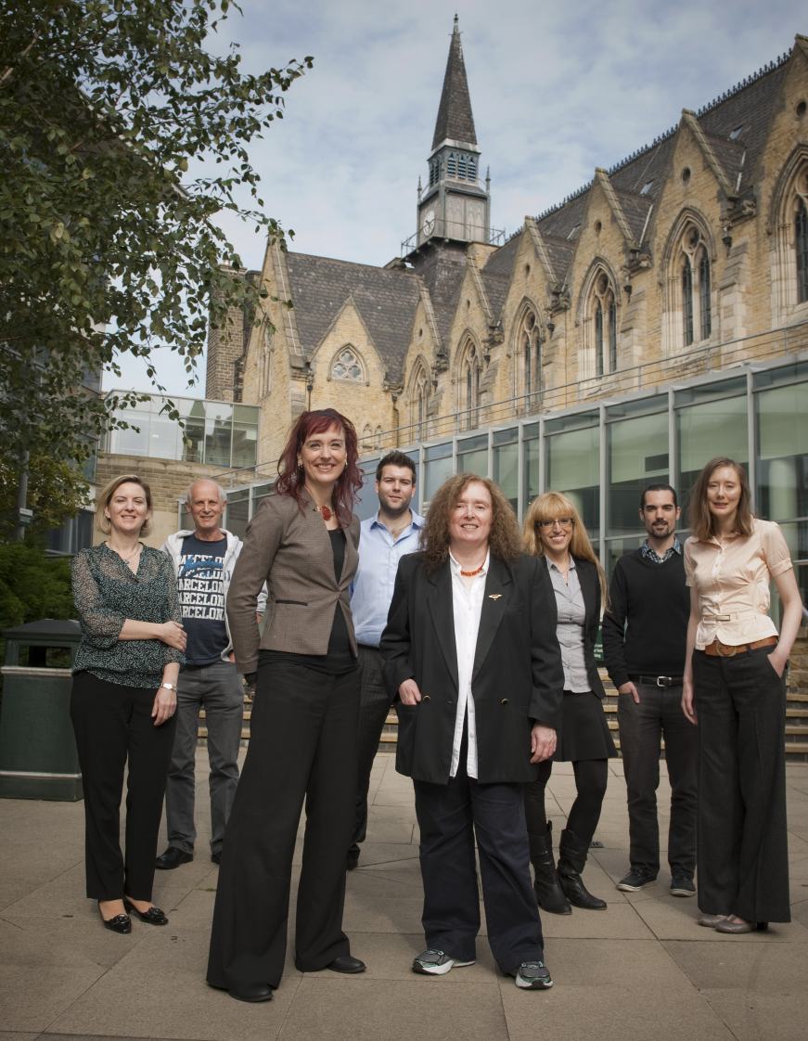
Website:
www.leeds.ac.uk/
decision-research/
Contact:
w.bruinedebruin@leeds.ac.uk
17
Notes:
17

